Slide 1
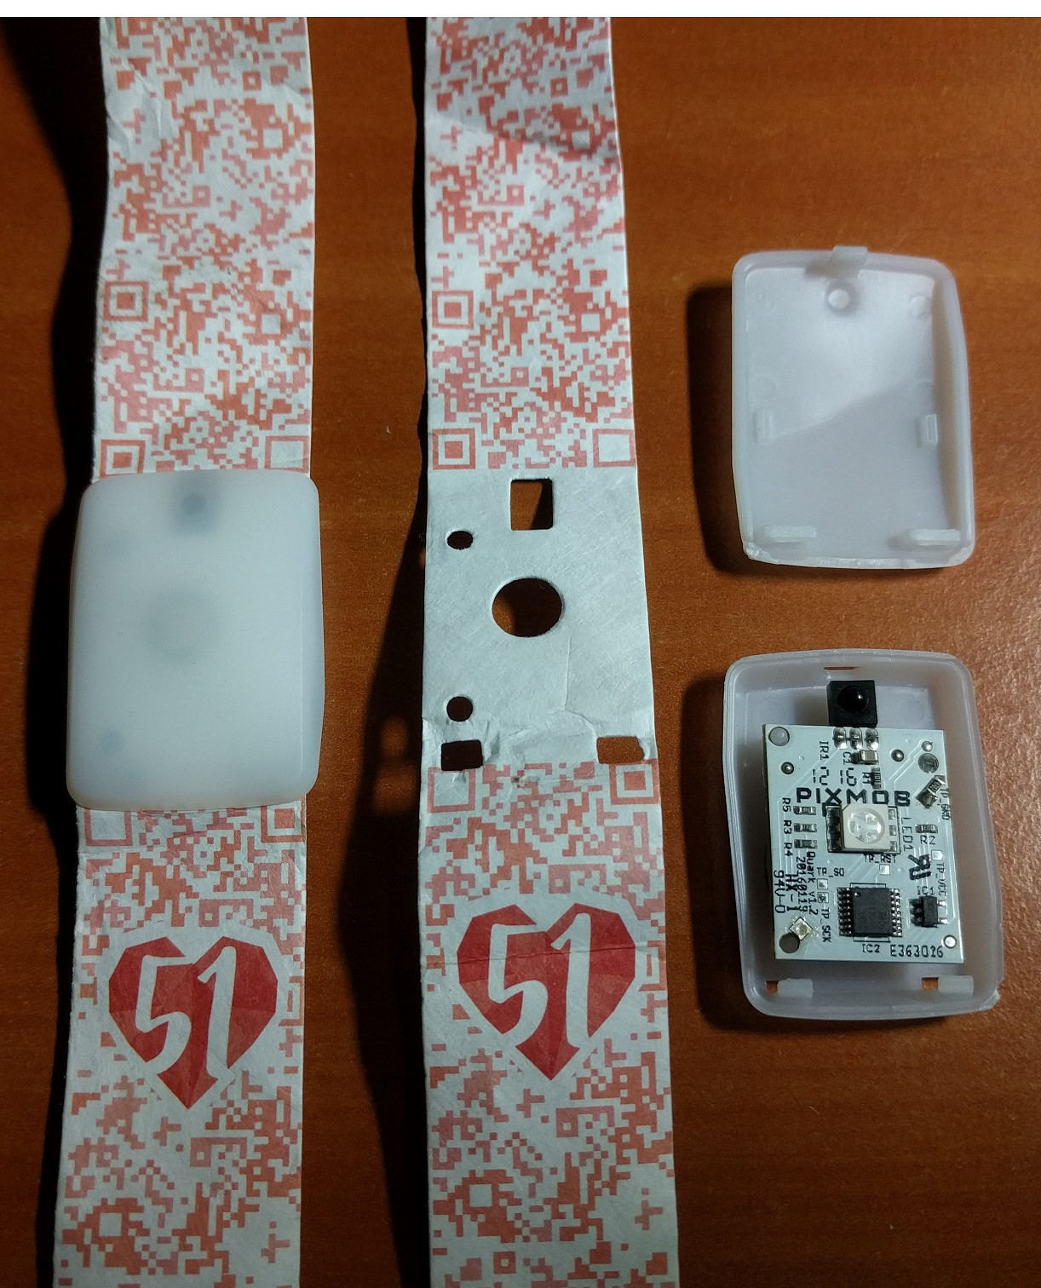
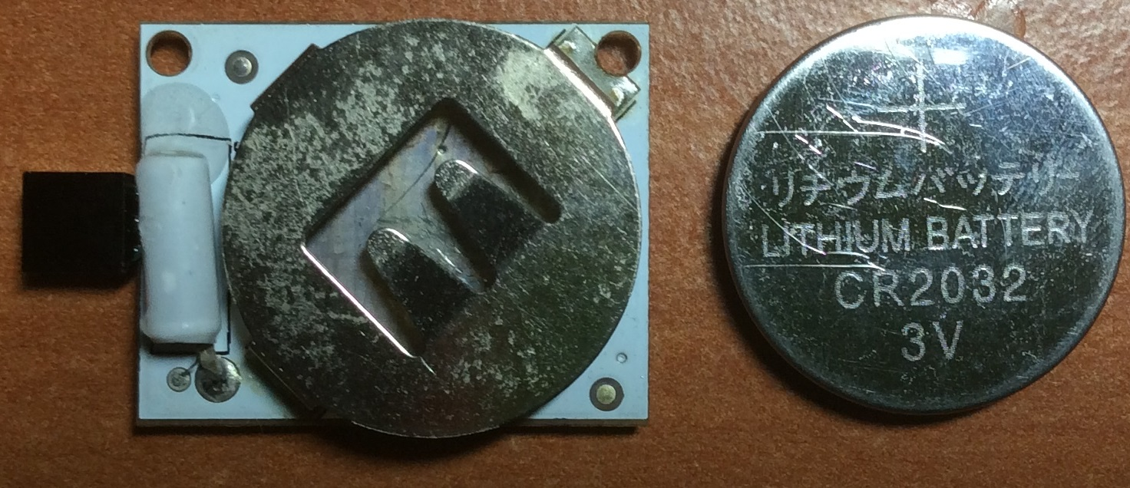
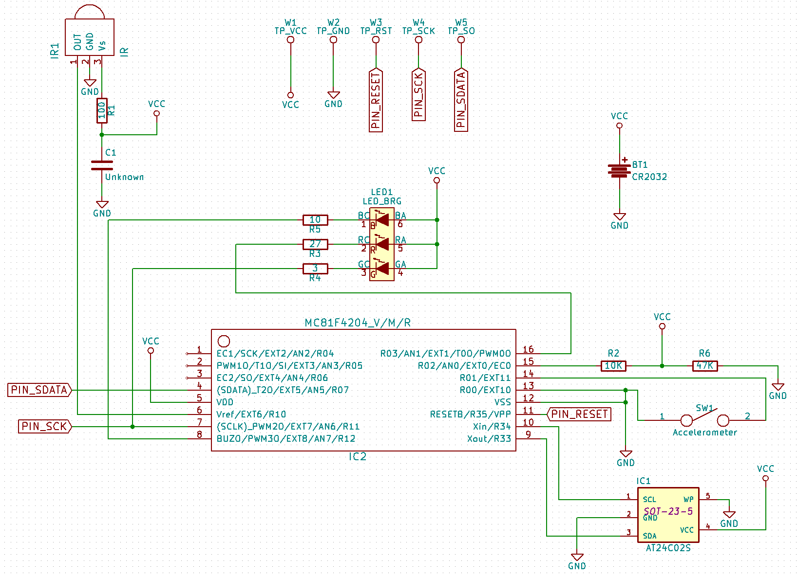
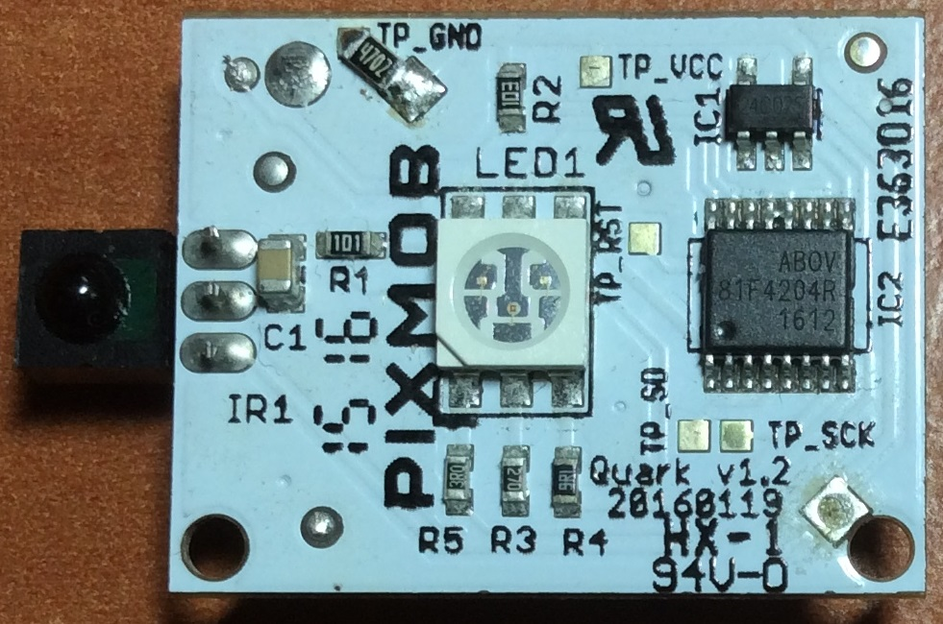
Partial reverse-engineering of the NDP 2016 LED Wristband
By: Yeo Kheng Meng (yeokm1@gmail.com)
https://github.com/yeokm1/reverse-engineering-ndp2016-wristband
http://yeokhengmeng.com/2016/08/partial-reverse-engineering-the-ndp-2016-led-wristband/
Hackware v2.1 (31 Aug 2016)

Slide 2
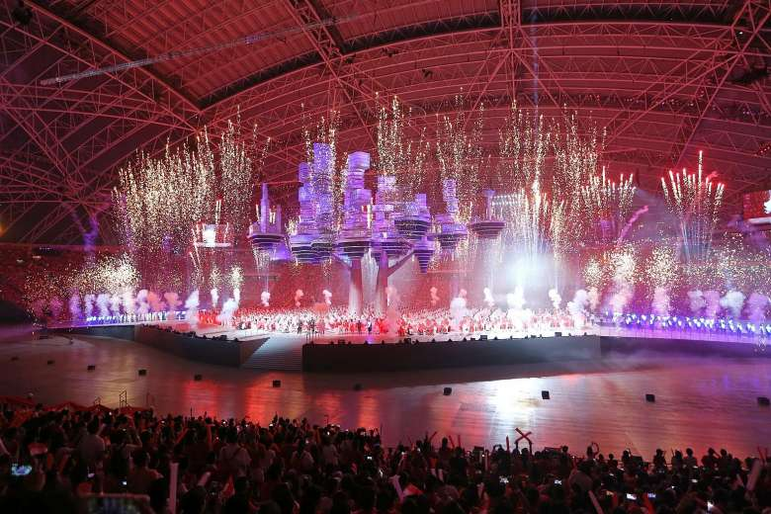
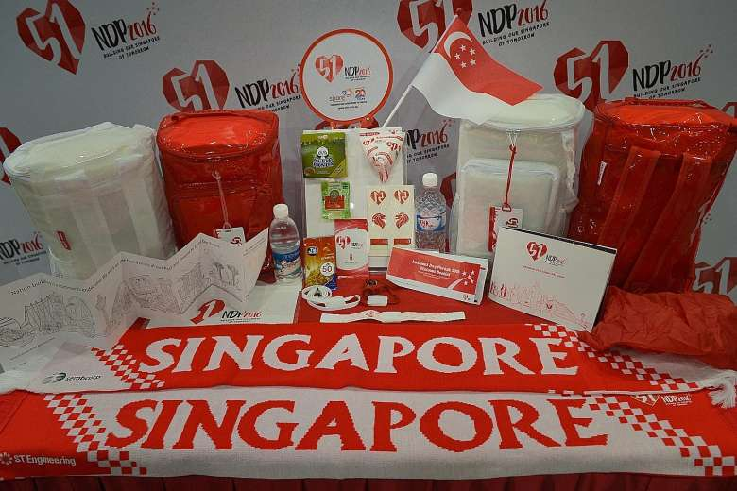
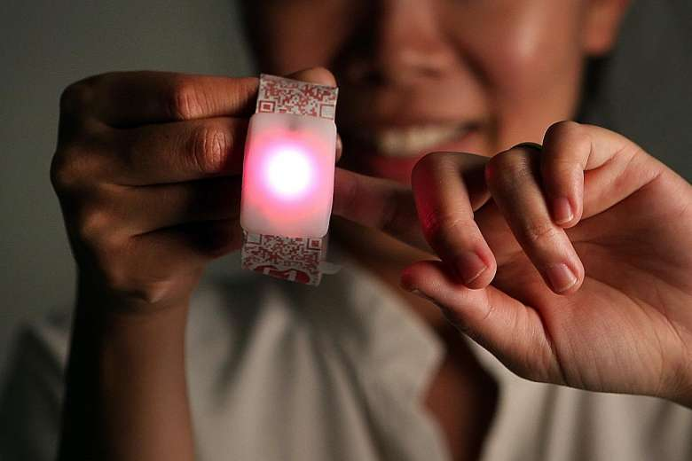
Background
Singapore gained independence on 9 August 1965
51st National Day Parade (NDP) on 9 August 2016
NDP 2016 held at National Stadium for $39.4 mil
Goodie bag contents
LED Wristband
http://www.straitstimes.com/singapore/ndp-goodie-bag-packs-futuristic-feel

Slide 3
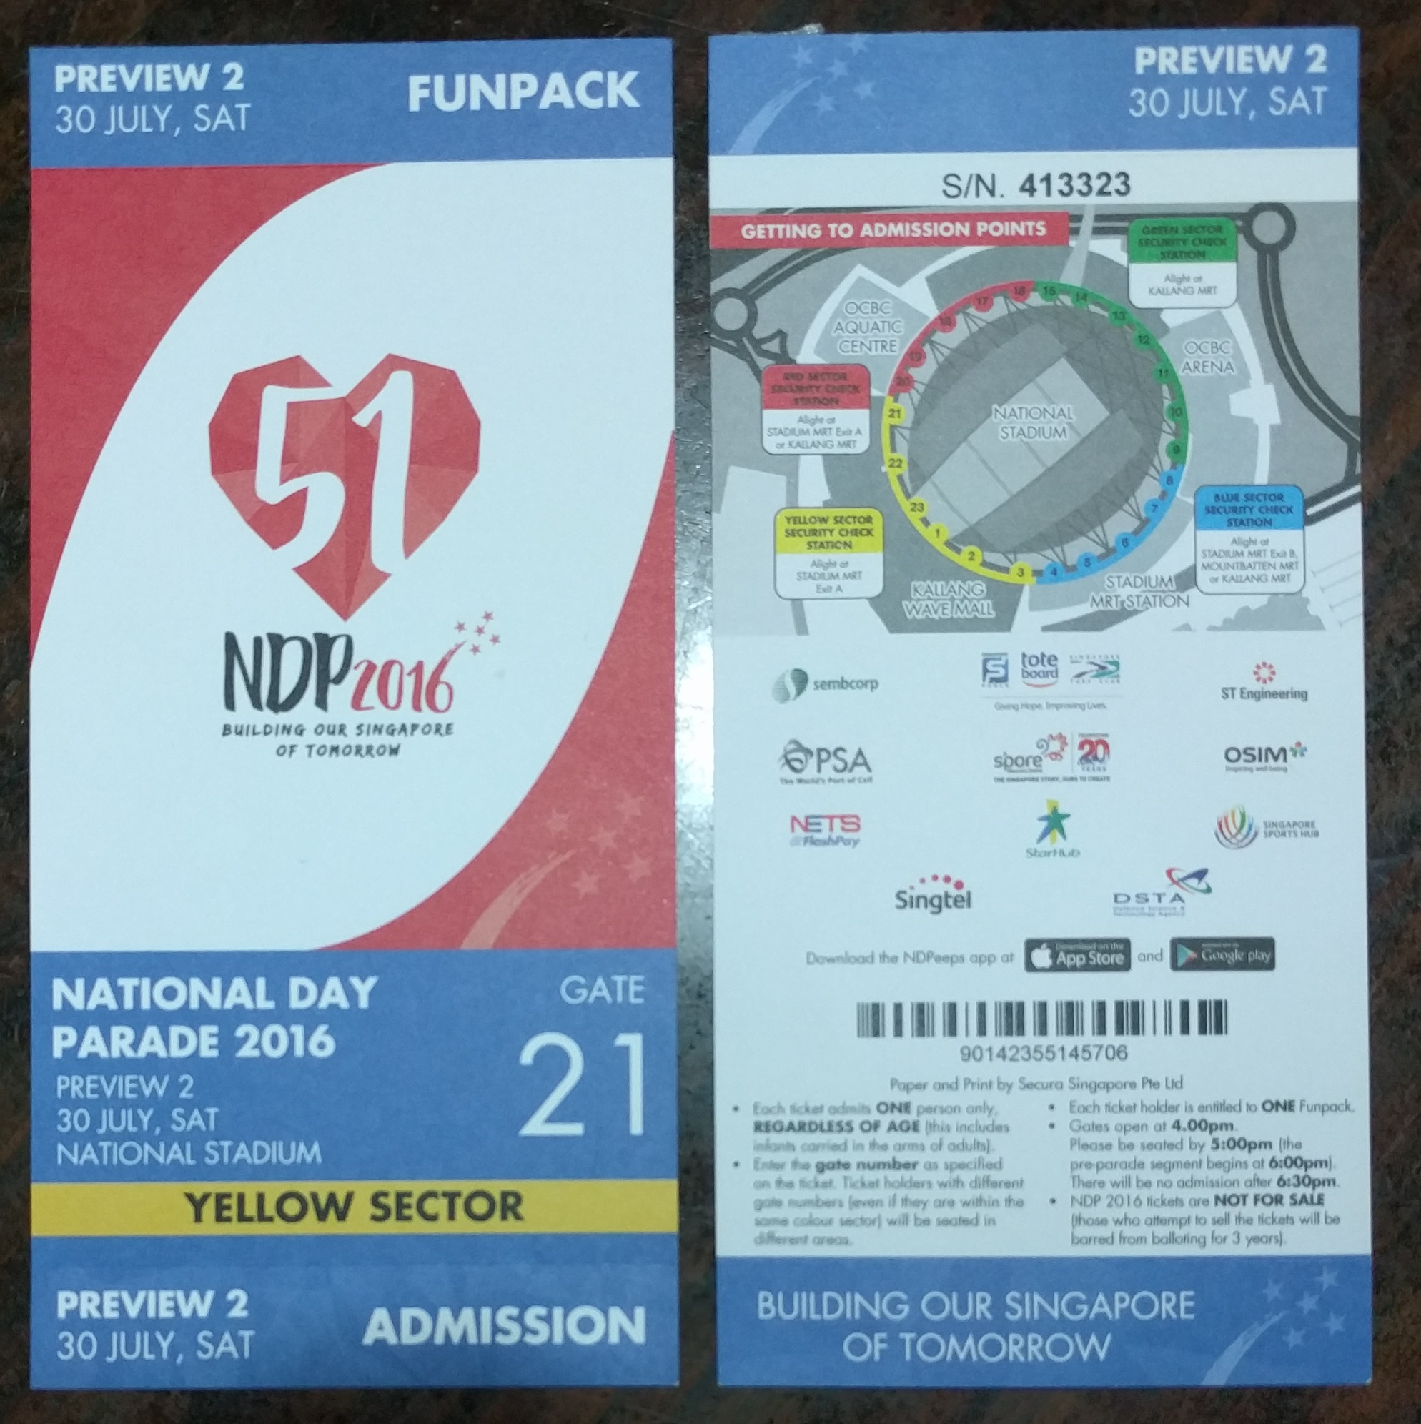

Wristband in action
Preview 2 on 30 July 2016
Colour theme for each segment
Band blinks the colour required
Blinks red when shaken post-event
Wristband blinking
https://www.youtube.com/watch?v=EPwxPJhlR4M
Wristband colour change
https://www.youtube.com/watch?v=XepiuPZ2TzA

Slide 4
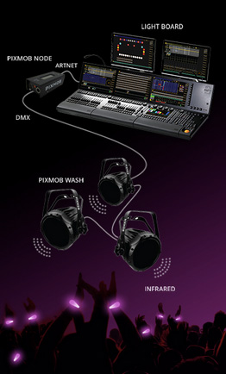
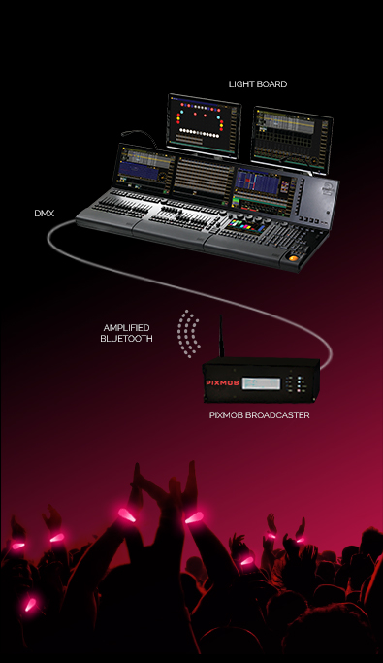
Research
Band manufactured by Pixmob: http://pixmob.com/
Professional (1500 to 150000 attendees) runs on infrared
Spark (Up to 1500 attendees) runs on Bluetooth Low Energy

Slide 5
Teardown
Front
IR1: Infrared Receiver
LED1: RGB LED
IC1: Atmel AT24C02S 2KB, 2-Wire Serial EEPROM (SOT23-5 package)
IC2: Abov 81F4204R 8-bit microcontroller (MCU) with 4KB ROM and 192B RAM (TSSOP16 package)
Back
Single-axis accelerometer
CR2032 battery holder

Slide 6
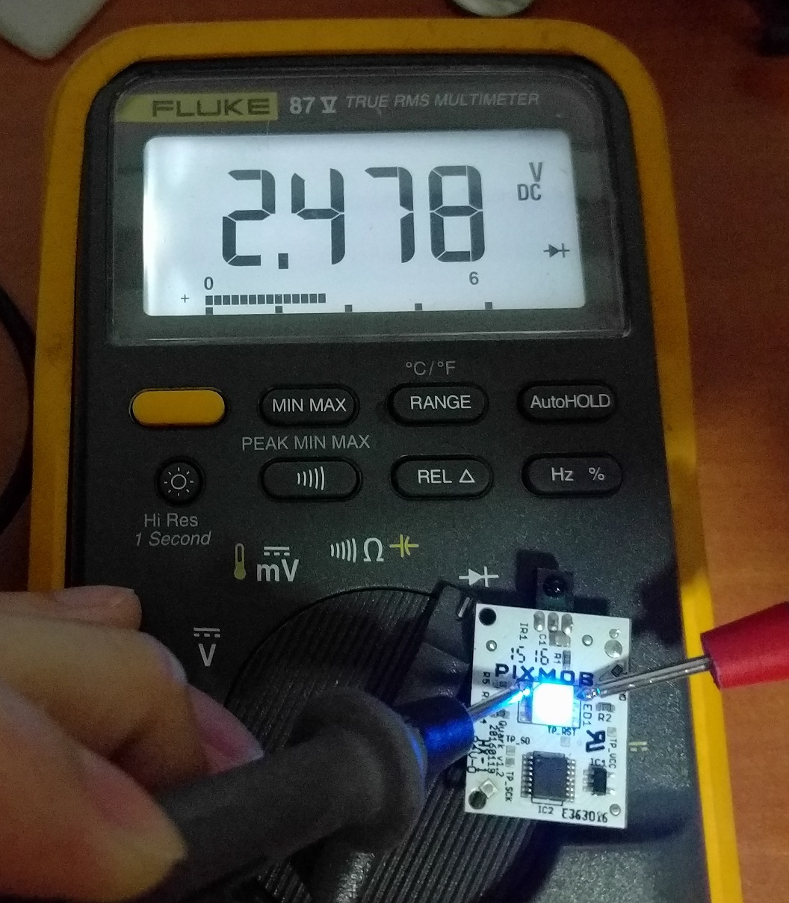
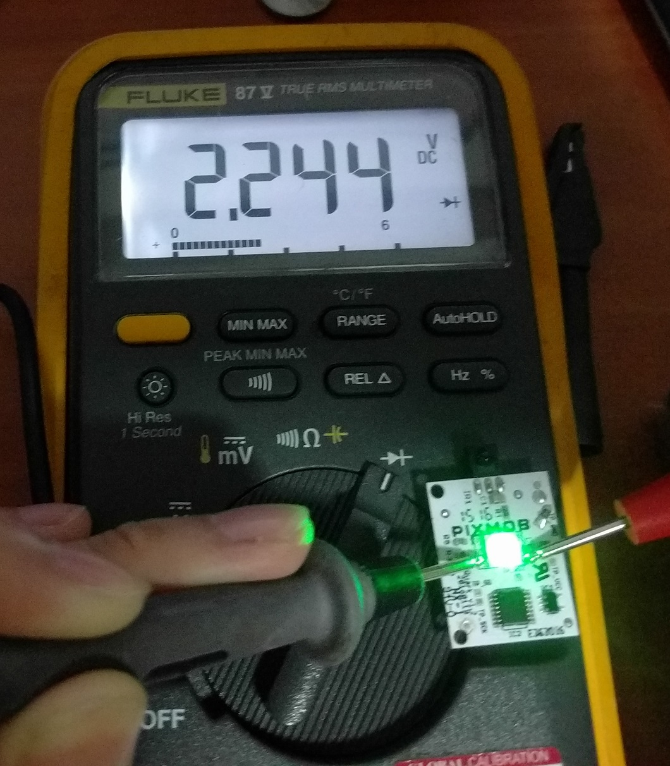
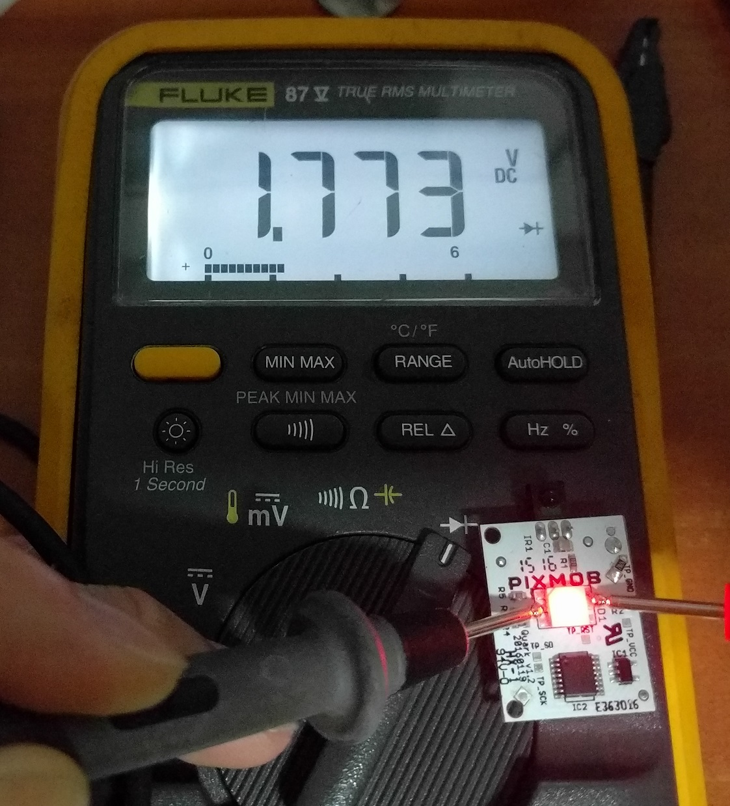
Hardware Reverse Engineering
With my Fluke 87 V

Slide 7
Reverse-engineered schematic
Abov MCU sinks LED current
Programming Pads SDATA, SCK
AT24C02S EEPROM uses I²C bus
MCU does not have hardware I²C
Pixmob engineers probably bit-bang GPIO
AT24C02S’s WP pin shorted to GND
Write-protection disabled
Parts
Single-axis accelerometer
CR2032 battery holder
IR1: Infrared Receiver
LED1: RGB LED
IC1: Atmel AT24C02S 2KB, 2-Wire Serial EEPROM (SOT23-5 package)
IC2: Abov 81F4204R 8-bit microcontroller (MCU) with 4KB ROM and 192B RAM (TSSOP16 package)

Slide 8
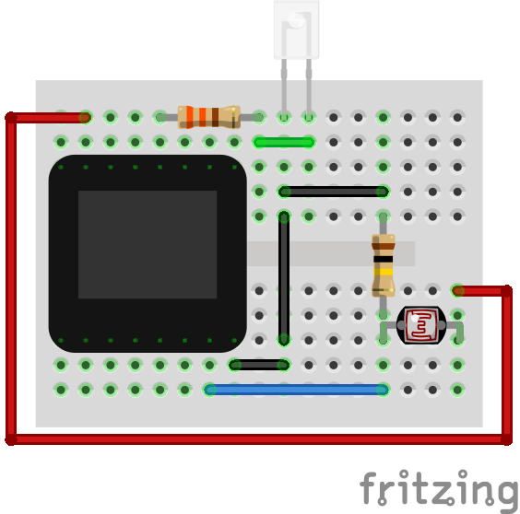
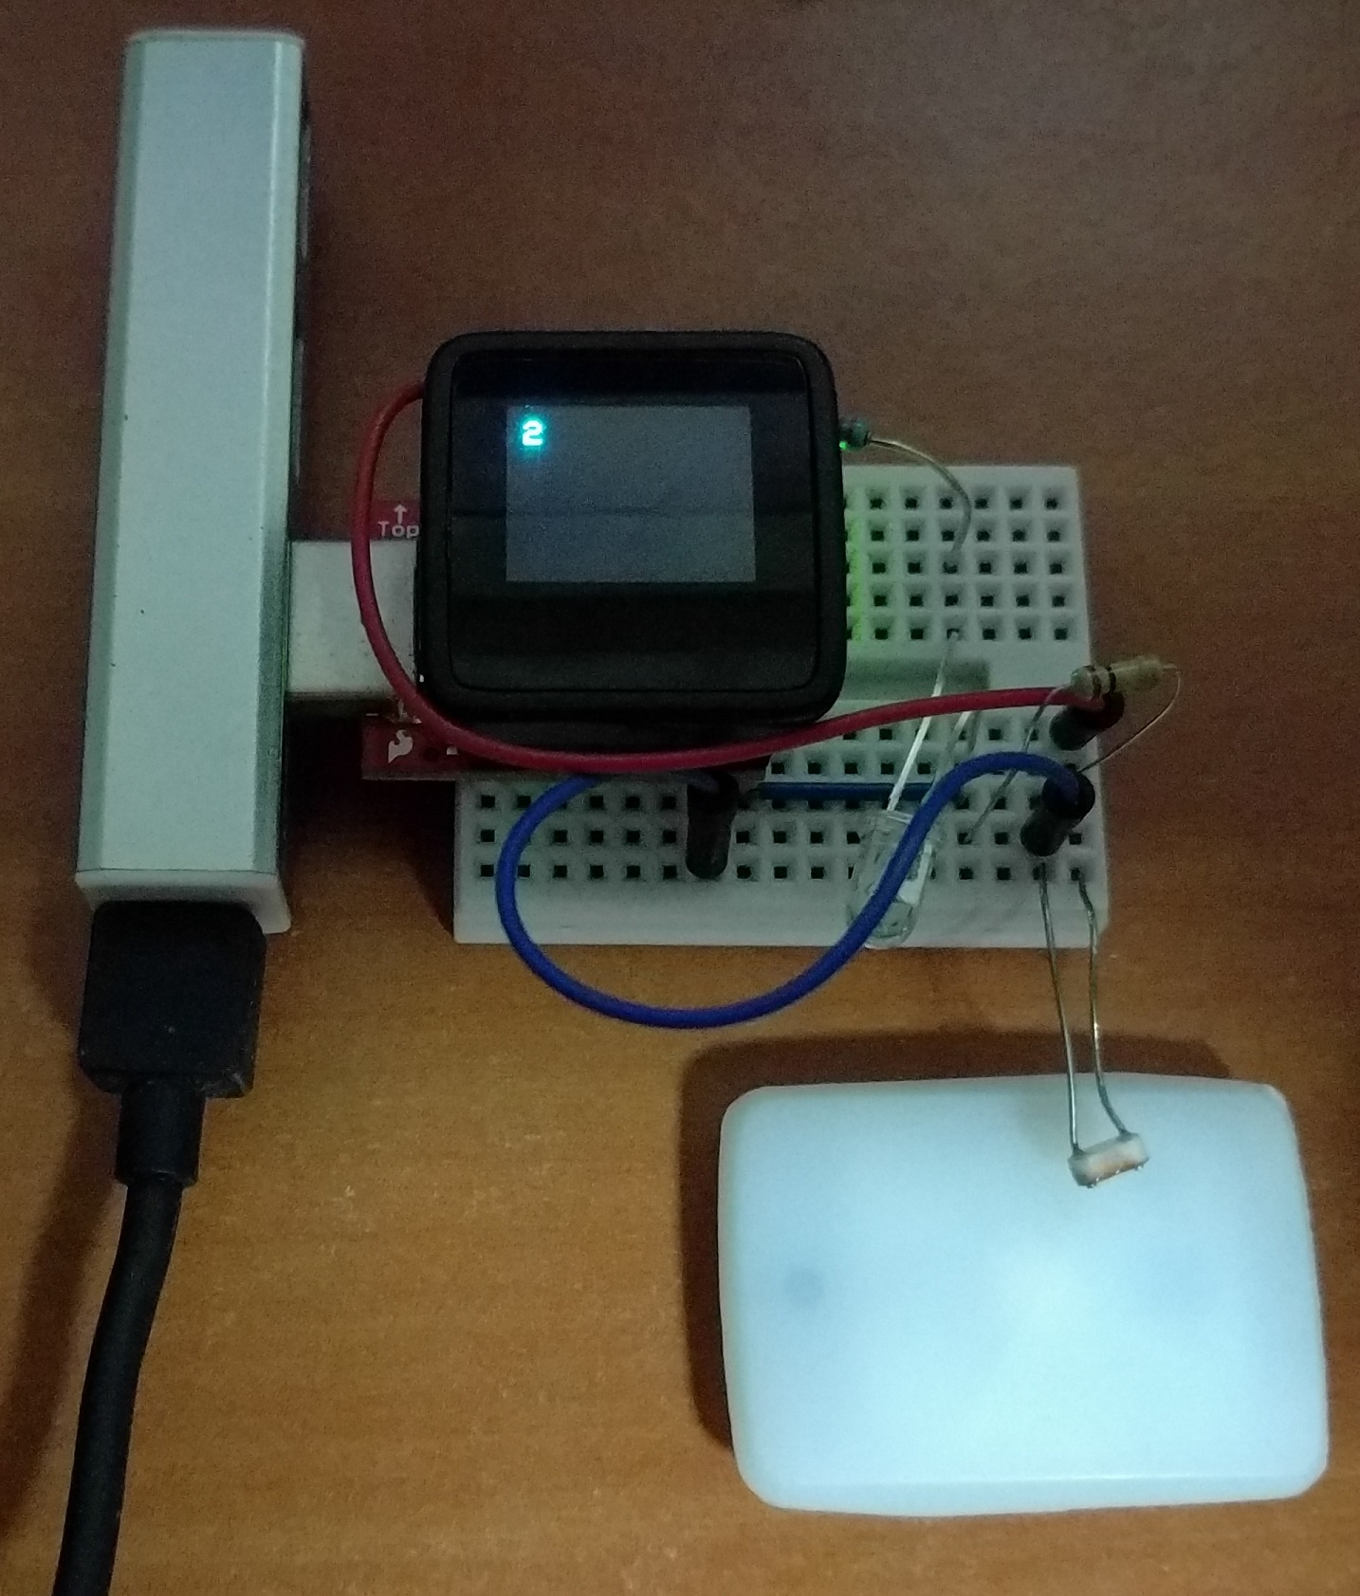
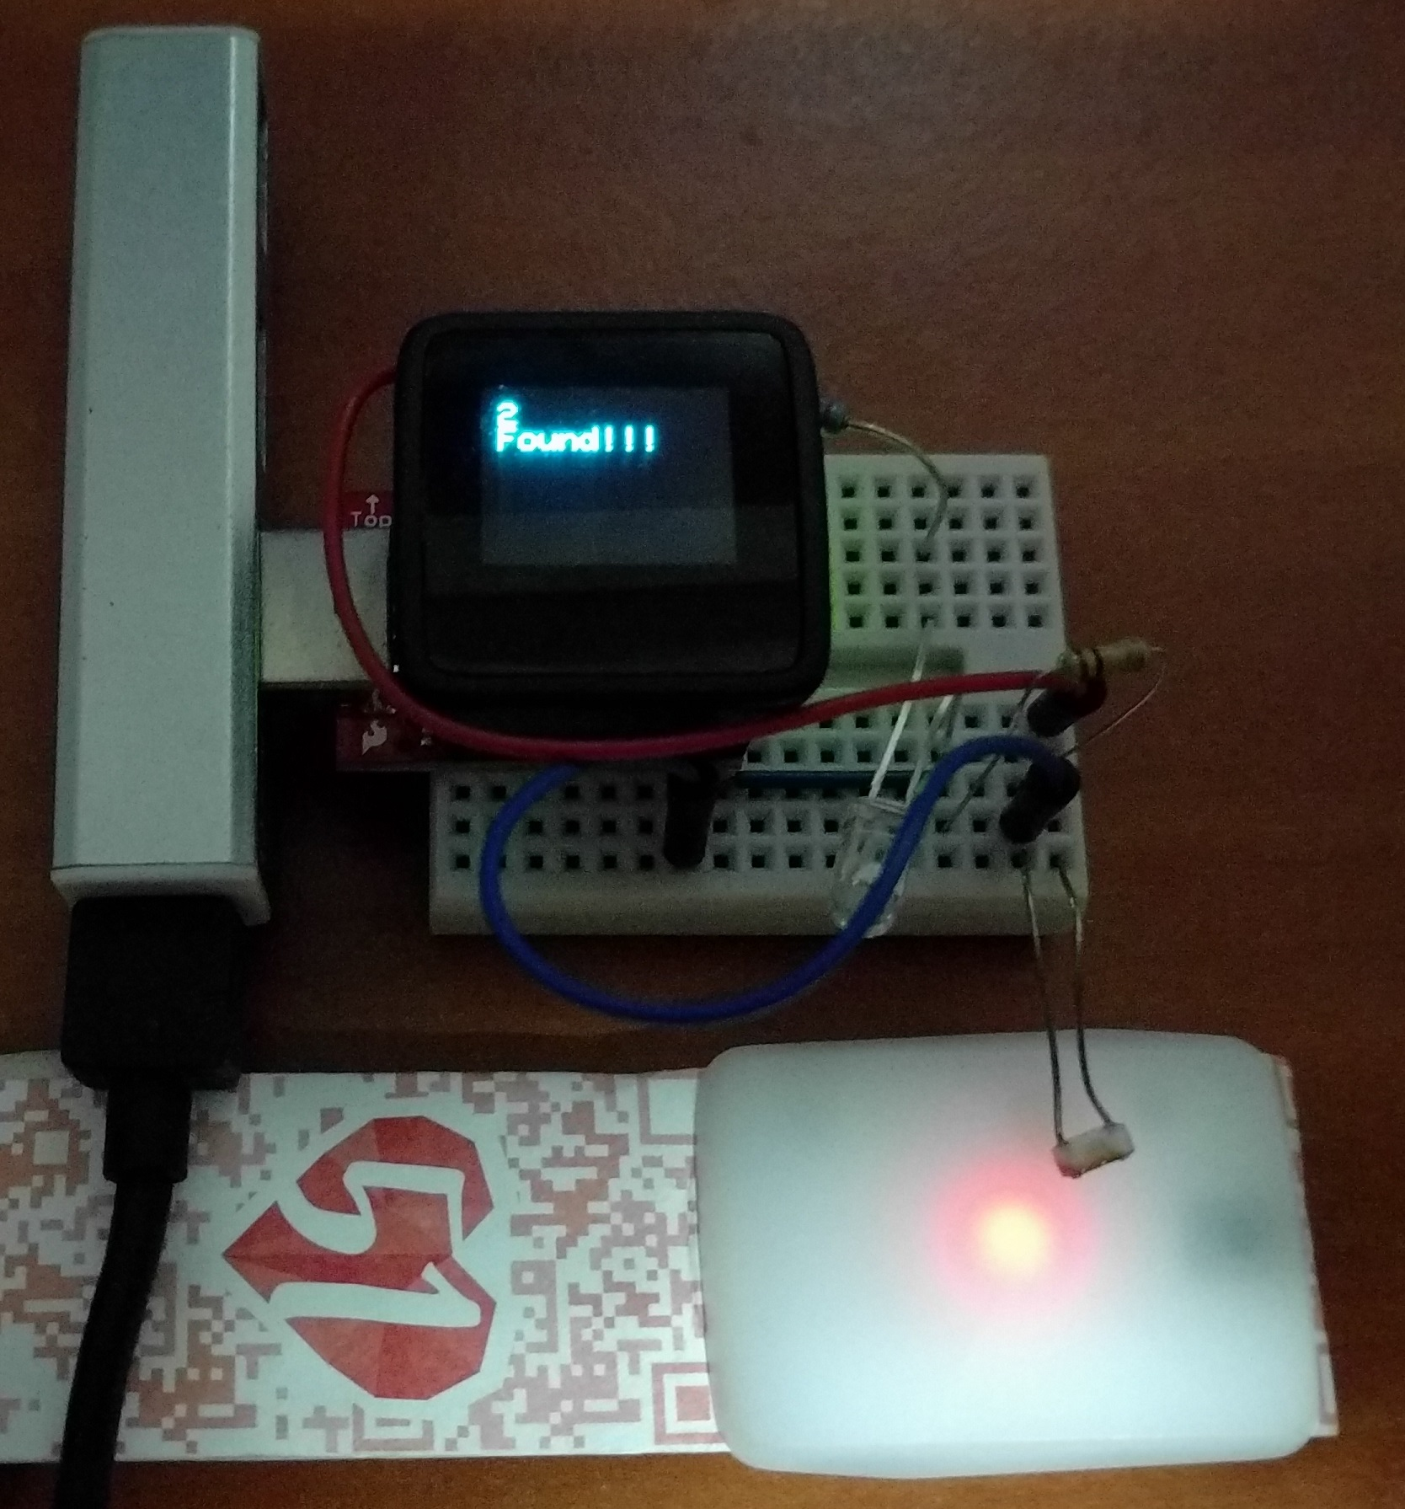
(Failed attempt to) Reverse Engineer IR Protocol
IR Brute Forcer
Microview
ATmega328p
OLED screen
IR LED
Photocell

Slide 9
Potential Work
Dump the ROM
Get IR Protocol from Pixmob

